Slide 1


Insert relevant picture related to the topic
TFB3323 FINTECH INNOVATION
WEEK III
P2P AND CROWDFUNDING
Shuhaida Bt M Shuhidan
(Dr (FSMC/UTP))
BACHELOR OF XXXXXX
DEPARTMENT OF COMPUTING
FACULTY OF SCIENCE, MANAGEMENT & COMPUTING
© 2026 INSTITUTE OF TECHNOLOGY PETRONAS SDN BHD
All rights reserved. No part of this document may be reproduced, stored in a retrieval system or transmitted in any form or by any means (electronic, mechanical, photocopying, recording or otherwise) without the permission of the copyright owner.

Slide 2
RECAP FROM PREVIOUS LECTURE
The Unbanked Problem: About 2.5 billion people worldwide are left out of the normal banking system. This is often because they do not have enough money, lack the right ID paperwork, or live too far from a bank branch.
The Goal of Financial Inclusion: The main aim is to make basic money services cheap, easy to reach, and useful for everyone, no matter how much money they have.
The Digital Solution: Digital financial services help solve this problem by cutting running costs, which leads to lower fees for users. They also allow people in remote areas to easily manage their money on their phones.
Roadblocks to Progress: Traditional banks have a hard time reaching these groups due to their high costs and outdated ways of doing business. On the customer side, a lack of financial knowledge and a general distrust of banks slow down progress.
China's Success Story: China has shown how well this works by using mobile apps and smart data to bring financial services to rural areas. This push has successfully helped reduce poverty and moved millions of low-income families into the middle class.
Notes:
Learning Outcomes Slide
Note:
Include 2–4 lecture-level learning outcomes
Use measurable action verbs
Map explicitly to Course Learning Outcomes (CLOs)

Slide 3
LEARNING OUTCOMES
By the end of this session, students will be able to:
Contrast Lending Models: Compare traditional bank lending with alternative Peer-to-Peer (P2P) platforms.
Identify Crowdfunding Types: Distinguish between the four main models: donation, reward, P2P lending, and equity crowdfunding.
Evaluate Benefits: Recognize how alternative lending fills funding gaps, lowers capital costs, and diversifies investor portfolios.
Analyze Competitive Advantages: Understand how P2P platforms leverage lower operational costs, speed, convenience, and alternative data sources.
Assess Industry Disruption: Examine the threat P2P lending poses to traditional banks and how these incumbent institutions are reacting.
Notes:
Learning Outcomes Slide
Note:
Include 2–4 lecture-level learning outcomes
Use measurable action verbs
Map explicitly to Course Learning Outcomes (CLOs)

Slide 4
TOPICS
Lending & Crowdfunding Introduction ?
1.1. Introduction to Lending
1.2. Crowdfunding
2. Alternative Models of Lending?
2.1. Traditional Lending Intermediaries?
2.2. Alternative Lending Platforms?
2.3. Key Characteristics (Problems) of Traditional Lending Models?
2.4. Key Characteristics of Alternative Lending Platforms
2.5. Traditional vs. Alternative Lending Models (Advantages & Limitations)
Crowdfunding Models
3.1. Donation Crowdfunding
3.2. Reward Crowdfunding
3.3. P2P Lending
3.4. Equity Crowdfunding
Unbundling – Breaking Up the Value Chain
4.1. “fit-for-single-purpose” solutions
4.2. Breaking Up Traditional Bank Value Chain
4.3. Credit-Scoring Models & Risk Mitigation
Notes:
Engagement and Activity Slides
Note:
Include at least one engagement element where appropriate:
Think–Pair–Share
Mini task
Poll or reflection question
Suggested duration: 3–5 minutes
Activities shall align with learning outcomes

Slide 5
TOPICS
Crowdfunding Motivations & Benefits?
5.1. Lower Cost of Capital & Higher Returns
5.2. Spreads Risk & Helps Economic Recovery
5.3. Fills a Gap Left by Banks
5.4. Provides a New Product for Portfolio Diversification
5.5. Increases Competition
Where Did Disruption Occur? (Lending)?
6.1. New Lending Techniques for Underbanked
Competitive Advantage of P2P Lending
7.1. More Cost-Efficient Funding Source & Cost Structure
7.2. Speed & Convenience
7.3. Lenders' Responsiveness
Strategies: Competitive Reactions of Banks and Other FIs
8.1. P2P Lending – Why Banks Should be Worried
8.2. Competitive Reactions of Incumbents
Notes:
Engagement and Activity Slides
Note:
Include at least one engagement element where appropriate:
Think–Pair–Share
Mini task
Poll or reflection question
Suggested duration: 3–5 minutes
Activities shall align with learning outcomes

Slide 6

P2P LENDING & CROWDFUNDING
Introduction

Slide 7
(Fintech) P2P Lending & Crowdfunding
1.1. Lending - Introduction
Banks use mostly centralized legacy technology infrastructure and rely heavily on expensive branches and manual processes. Moreover, given their role in the recent financial crisis, they will keep facing increasing capital and regulatory constraints
For Banks will continue to pull away from lending to “risky” clients. Given their high-cost base, banks cannot afford to underwrite and lend money in small amounts, as would be convenient for clients.
Uncertainty and delay in loan disbursement, high processing fees, lock-in periods, pre-closure charges (the process when one repays the loan before the loan tenure ends) make access to credit near impossible to many entrepreneurs.
The cost of enforcing loan repayments is an important component of total financial intermediation cost. To reduce enforcement problems banks usually require borrowers to pledge tangible assets, such as real estate, as collateral to increase recovery rates in the case of default.
Notes:
Engagement and Activity Slides
Note:
Include at least one engagement element where appropriate:
Think–Pair–Share
Mini task
Poll or reflection question
Suggested duration: 3–5 minutes
Activities shall align with learning outcomes

Slide 8
(Fintech) P2P Lending & Crowdfunding
1.1. Crowdfunding- Defined
Crowd-funding is an umbrella term describing the use of small amounts of money, obtained from a large number of individuals or organizations, to fund a project, a business or personal loan, and other needs through an online web-based platform.
Crowdfunding describes a form of financing in which a large number of contributors (often called “backers”) provide the financial resources to achieve a common goal. In the place of a traditional bank, a crowdfunding portal acts as an intermediary (Belleflamme et al. 2014; Kl€ohn and Hornuf 2012).
Notes:
Engagement and Activity Slides
Note:
Include at least one engagement element where appropriate:
Think–Pair–Share
Mini task
Poll or reflection question
Suggested duration: 3–5 minutes
Activities shall align with learning outcomes

Slide 9
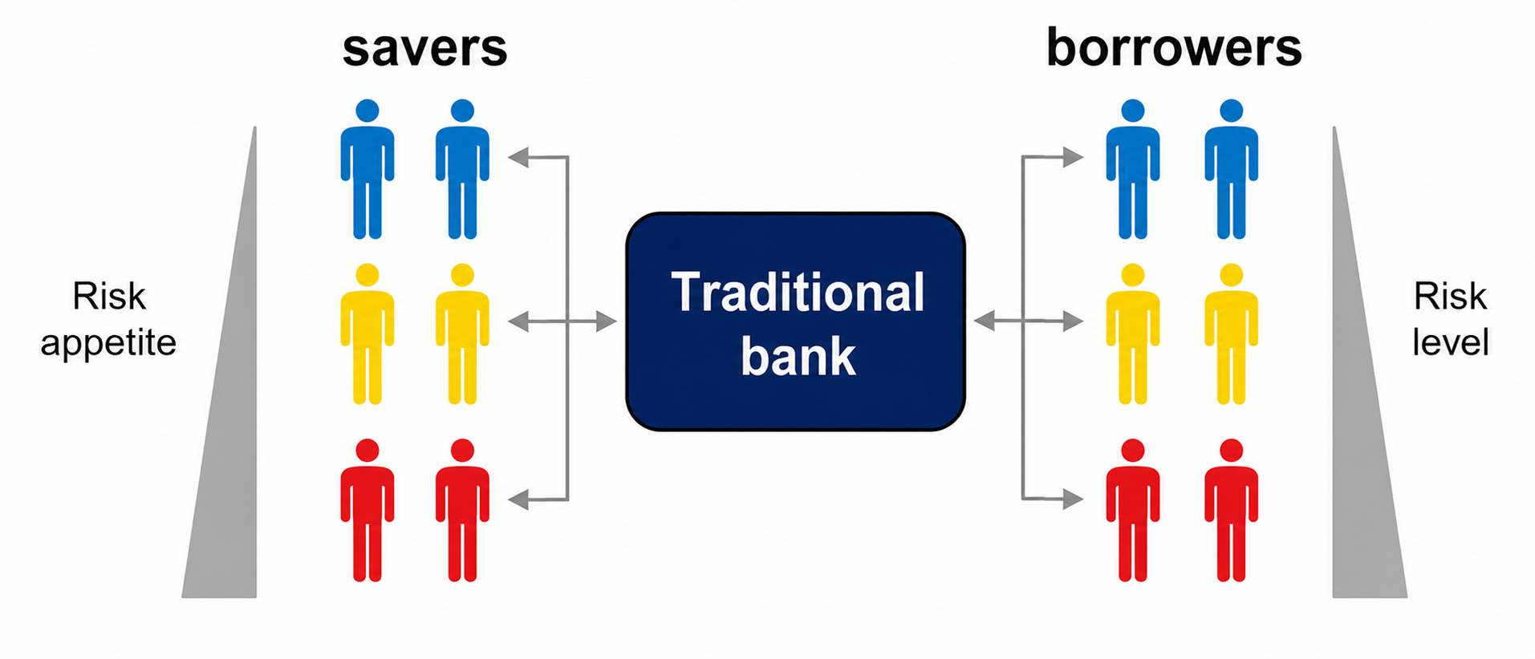
Financial Technology – Alternative Lending
1.1. Traditional Lending Intermediaries
++ Lenders’ savings are protected by the intermediaries’ reserves and by deposit insurance schemes
++ The complete pooling of savings and loans most effectively mitigates individual default risks
-- Lenders do not have flexibility to determine the desired level of risk and return
-- Primary focus on low-risk loans exclude higher risk borrowers, depending on the market conditions
Notes:
Engagement and Activity Slides
Note:
Include at least one engagement element where appropriate:
Think–Pair–Share
Mini task
Poll or reflection question
Suggested duration: 3–5 minutes
Activities shall align with learning outcomes

Slide 10
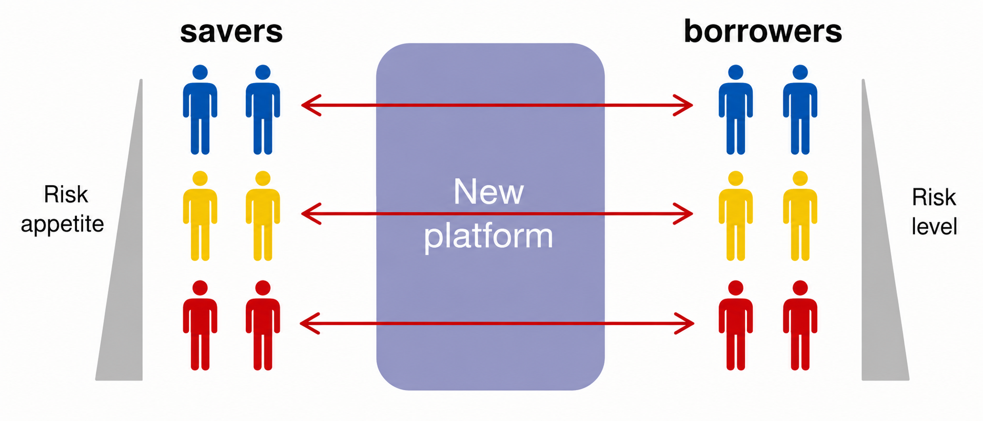
Financial Technology – Alternative Lending
1.1. Alternative Lending Intermediaries
++ Reduction of transaction costs
++ Traditionally underserved borrowers gain access to loans and diverse risk appetite of lenders is met
-- Investments may be more susceptible to individual default risks even with portfolio approach, especially for smaller investments
-- Guarantees on the investments are limited
Notes:
Engagement and Activity Slides
Note:
Include at least one engagement element where appropriate:
Think–Pair–Share
Mini task
Poll or reflection question
Suggested duration: 3–5 minutes
Activities shall align with learning outcomes

Slide 11
(Deposits & Lending (Alternative Models of Lending)
1.1. P2P Lending
P2P loans are sponsored by private investors who sign up for accounts and choose which loans to fund, unlike large financial institutions that fund loans with huge pockets.
P2P lending, in laymen’s terms, is a monetary agreement between a lender and borrower without the involvement of any financial institutions in between, such as a bank.
The online company facilitating this Peer-to-Peer exchange will act as the risk mitigator between these two parties by adequately assessing their eligibility in these digital transactions.
Notes:
Engagement and Activity Slides
Note:
Include at least one engagement element where appropriate:
Think–Pair–Share
Mini task
Poll or reflection question
Suggested duration: 3–5 minutes
Activities shall align with learning outcomes

Slide 12
(Deposits & Lending (Alternative Models of Lending)
1.1. Key characteristics (Problems) of traditional Lending models
Limited Access. A growing lending gap limits the availability of loans to individuals and companies with higher risk profiles.
Slow Speed. Traditional adjudication processes with multiple layers of approval limits the banks’ ability to process loans in timely manner.
Margin for Error. Traditional adjudication models and credit scores tend to miss suitable lending opportunities in a virtual economy.
Poor Customer Experience. Highly manual adjudication processes and requirements fall short of increasing expectations on customer experiences.
Notes:
Engagement and Activity Slides
Note:
Include at least one engagement element where appropriate:
Think–Pair–Share
Mini task
Poll or reflection question
Suggested duration: 3–5 minutes
Activities shall align with learning outcomes

Slide 13
Deposits & Lending (Alternative Models of Lending)
Limited Control. Borrowers have limited visibility and control over the uses of funds and interest rates earned.
Low Return. Operational inefficiency and reduced risk appetite of banks result in low returns on savings.
Notes:
Summary and Closure Slides
Note:
Summarise 3–5 key takeaways
Reinforce main ideas
Indicate CLO coverage where appropriate
Include:
Upcoming topics
Required reading
Tutorial / lab / assessment linkage

Slide 14
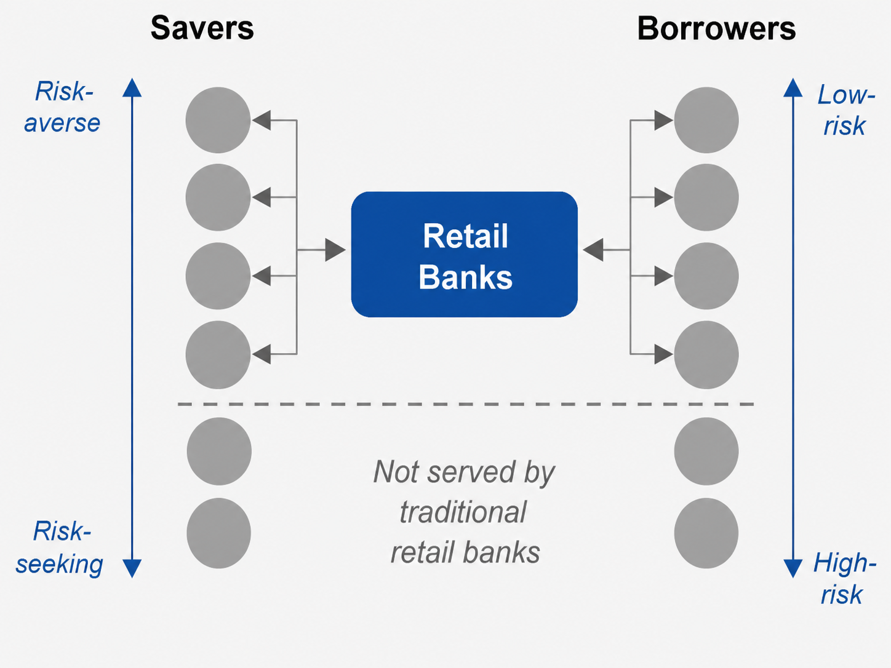
(Deposits & Lending (Alternative Models of Lending)
1.1. Alternative Models of Lending- Core Capabilities
How do financial institutions facilitate lending activities today? (continue…)
Notes:
Engagement and Activity Slides
Note:
Include at least one engagement element where appropriate:
Think–Pair–Share
Mini task
Poll or reflection question
Suggested duration: 3–5 minutes
Activities shall align with learning outcomes

Slide 15
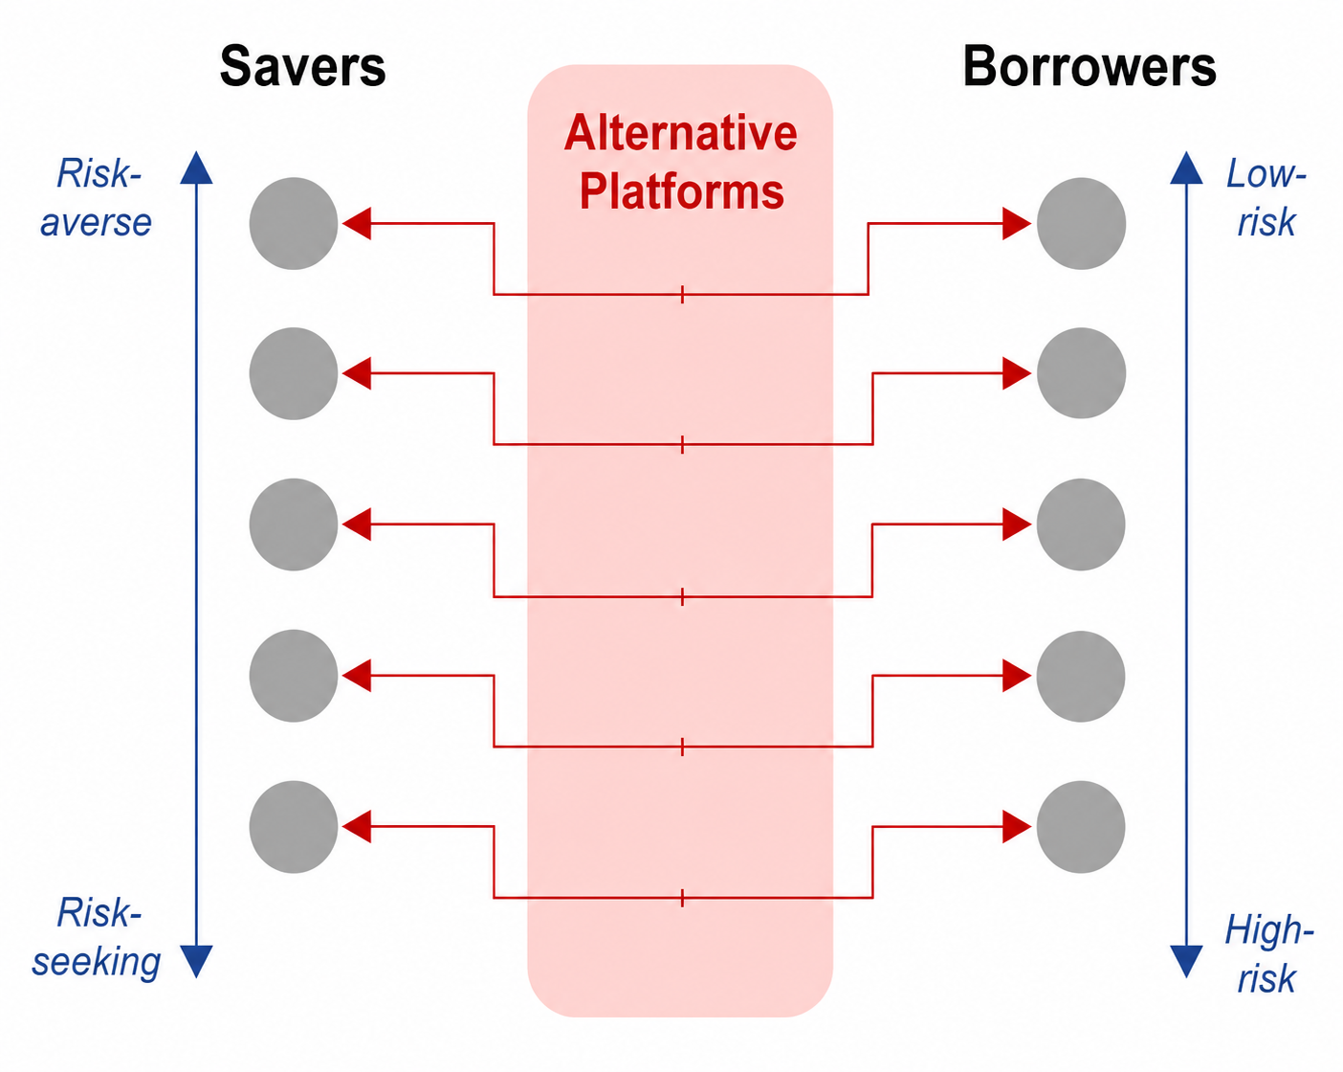
(Deposits & Lending (Alternative Models of Lending)
1.1. Alternative Models of Lending- Core Capabilities
Description of alternative lending models (continue...)
Notes:
Engagement and Activity Slides
Note:
Include at least one engagement element where appropriate:
Think–Pair–Share
Mini task
Poll or reflection question
Suggested duration: 3–5 minutes
Activities shall align with learning outcomes

Slide 16
Deposits & Lending (Alternative Models of Lending)
1.1. Key characteristics of alternative lending platforms
P2P
Alternative lenders leverage online platforms and legal contracts to provide direct matching of funds between savers and borrower.
By acting as online marketplaces P2P lenders facing lower funding costs than traditional depository lenders
Alternative processes and metrics
Alternative lending platforms assess the creditworthiness of borrowers based on metrics beyond the credit scores used by traditional lenders (e.g., social data).
Most alternative lenders also refine their risk engine more frequently than traditional lenders to incorporate feedback based on empirical analysis.
Notes:
Engagement and Activity Slides
Note:
Include at least one engagement element where appropriate:
Think–Pair–Share
Mini task
Poll or reflection question
Suggested duration: 3–5 minutes
Activities shall align with learning outcomes

Slide 17
Deposits & Lending (Alternative Models of Lending)
Lean, automated processes
Alternative lending platforms are free of legacy processes and technologies, allowing them to onboard and assess borrowers and lenders in a more streamlined fashion
(quick and efficient manner)
At most alternative platforms, assessment of borrowers is at least partly automated against predefined rules for fast, transparent processing.
Notes:
Engagement and Activity Slides
Note:
Include at least one engagement element where appropriate:
Think–Pair–Share
Mini task
Poll or reflection question
Suggested duration: 3–5 minutes
Activities shall align with learning outcomes

Slide 18
CROWDFUNDING
Crowdfunding
Models

Slide 19
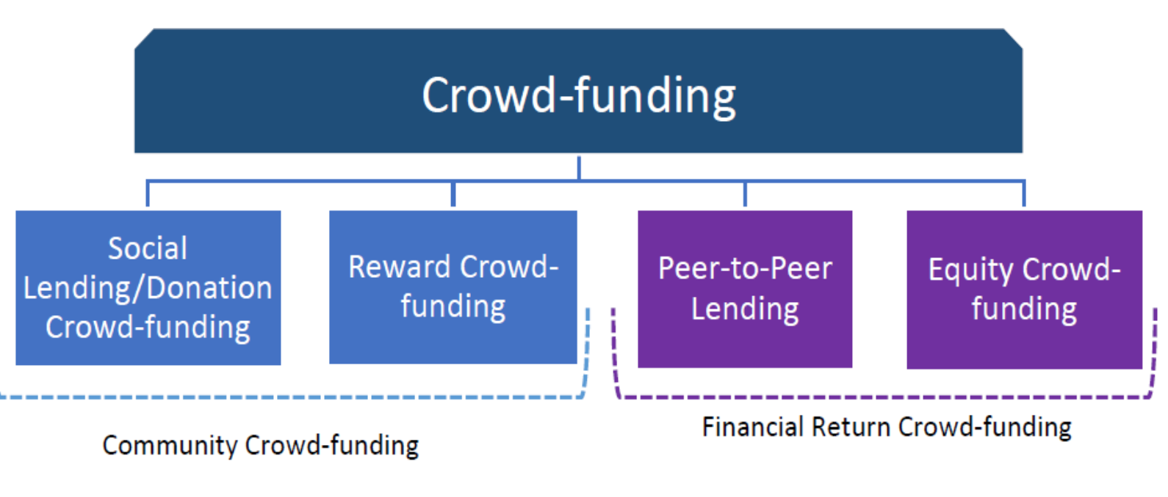
Lending – Crowdfunding Models
1.1. Crowdfunding Models
Notes:
Engagement and Activity Slides
Note:
Include at least one engagement element where appropriate:
Think–Pair–Share
Mini task
Poll or reflection question
Suggested duration: 3–5 minutes
Activities shall align with learning outcomes

Slide 20
Lending – Crowdfunding Models
1.1. Donation Crowdfunding
People give their money to a project or idea and do not expect anything in exchange for the money (as the word ‘donation’ suggests). This is the typical form of crowdfunding used by not-for-profit and charitable organisations, including disaster-relief campaigns and election campaigns
Notes:
Engagement and Activity Slides
Note:
Include at least one engagement element where appropriate:
Think–Pair–Share
Mini task
Poll or reflection question
Suggested duration: 3–5 minutes
Activities shall align with learning outcomes

Slide 21
Lending – Crowdfunding Models
1.1. Reward Crowdfunding
As with donation crowdfunding, people give their money to a project or idea, but they obtain a gift in return for the investment. This gift can take several types of material (tangible) forms, but it can never be financial.
Reward based: donating small amounts to meet the larger funding aim of a specific project with the expectation of receiving a tangible (but non-financial) reward or product in return.
Social lending/donation crowd-funding and reward crowd-funding are a way of fundraising for charitable causes, for example through angel investors, or pre-paying for a product from a business, for example NakedWines.com.
These two categories of crowd-funding can be collectively referred to as “community crowd-funding”
Notes:
Engagement and Activity Slides
Note:
Include at least one engagement element where appropriate:
Think–Pair–Share
Mini task
Poll or reflection question
Suggested duration: 3–5 minutes
Activities shall align with learning outcomes

Slide 22
Lending – Crowdfunding Models
1.1. P2P Lending
As with Peer-to-peer lending is a form of crowd-funding used to fund loans which are paid back with interest. Equity crowd-funding is the raising of capital through the issuance of stock to a number of individual investors using the same method as crowd-funding.
Peer-to-peer lending and equity crowd-funding platforms are of particular interest because they are growing rapidly and are accessible easily to both retail and sophisticated investors alike.
Notes:
Engagement and Activity Slides
Note:
Include at least one engagement element where appropriate:
Think–Pair–Share
Mini task
Poll or reflection question
Suggested duration: 3–5 minutes
Activities shall align with learning outcomes

Slide 23
Lending – Crowdfunding Models
1.1. Equity Crowdfunding
In this form of crowdfunding, the crowd is asked to support a project or idea by buying stakes of the company that may or may not include voting rights. The financial return is in the form of the dividends and/or the capital gain. Contrary to other forms of crowdfunding in which projects or ideas can originate from individuals as well as from companies, equity crowdfunding is exclusively for either start-up firms or existing companies seeing risk capital.
Recently, equity crowdfunding has sometimes been named crowdinvesting to distinguish it from other forms of crowdfunding..
Notes:
Engagement and Activity Slides
Note:
Include at least one engagement element where appropriate:
Think–Pair–Share
Mini task
Poll or reflection question
Suggested duration: 3–5 minutes
Activities shall align with learning outcomes

Slide 24
Deposits & Lending (Alternative Models of Lending)
Equity crowdfunding is typically employed by companies seeking seed capital they cannot obtain through traditional funding channels. Two forms of equity crowdfunding can be distinguished, depending on the types of peer involved in the relationship:
P2B equity crowdfunding, whereby individuals give financial resources to start-up or existing firms.
business-to-business (B2B) equity crowdfunding, whereby the crowd of investors comprises other companies, which may or may not also act as angel investors
Notes:
Engagement and Activity Slides
Note:
Include at least one engagement element where appropriate:
Think–Pair–Share
Mini task
Poll or reflection question
Suggested duration: 3–5 minutes
Activities shall align with learning outcomes

Slide 25
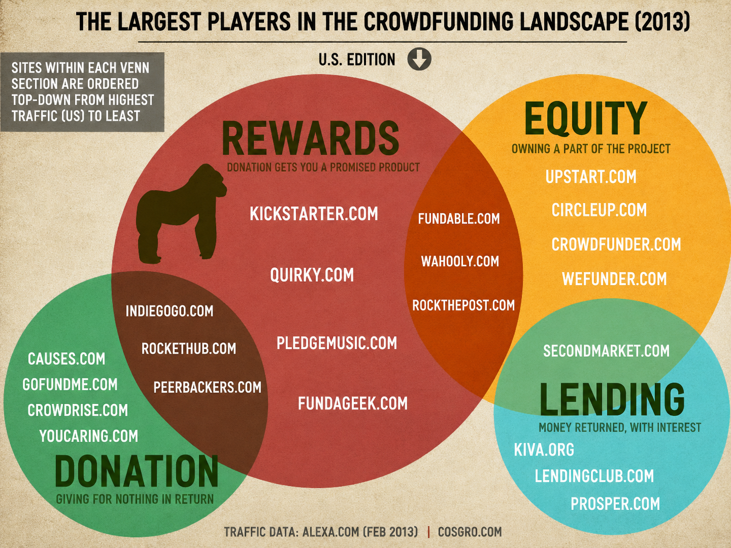
The Largest Players in the Crowdfunding Landscape (2013)
Notes:
Engagement and Activity Slides
Note:
Include at least one engagement element where appropriate:
Think–Pair–Share
Mini task
Poll or reflection question
Suggested duration: 3–5 minutes
Activities shall align with learning outcomes

Slide 26
CROWDFUNDING
Facts / Considerations

Slide 27
Lending – Crowdfunding Models
1.1. Crowdfunding – Fees
Generally, there are no costs to individuals for initiating projects in the reward-based and donation based crowdfunding subsegments. Some portals charge a fee of between 5% and 11% of the total amount of funding in the case of a successful campaign. Other portals gain revenue through voluntary donations from investors and the initiators of the projects
Notes:
Engagement and Activity Slides
Note:
Include at least one engagement element where appropriate:
Think–Pair–Share
Mini task
Poll or reflection question
Suggested duration: 3–5 minutes
Activities shall align with learning outcomes

Slide 28
Lending – Crowdfunding Models
1.1. Crowdfunding – Costs
The majority of crowdfunding platforms are for-profit organisations. If a project is successfully funded, platforms will take a percentage of the total amount raised. The percentage varies from platform to platform and ranges between 3% and 12% of total raised.
Note that the success fee will vary depending on the fundraising model chosen. For instance, a higher fee is usually charged on the “Take it all” model. There are also platforms that charge no success fee, however these are rarer. (Receive all funds regardless whether fundraishing goal is met)
Notes:
Engagement and Activity Slides
Note:
Include at least one engagement element where appropriate:
Think–Pair–Share
Mini task
Poll or reflection question
Suggested duration: 3–5 minutes
Activities shall align with learning outcomes

Slide 29
Lending – Crowdfunding Models
1.1. Crowdfunding – Facts / Considerations
When they receive applications, P2P lending platforms make specific formal checks aimed at complying with legal requirements, for example, on money laundering, and at identifying opportunistic behavior on the part of individuals or firms with questionable or fraudulent purposes.
Besides, the essentially domestic nature of P2P lending, the relatively undeveloped crossborder activity and the promotion of proximity relationships, that is, between individuals or firms belonging to groups or virtual communities, tend to limit damage from adverse-selection and moral hazard.
Notes:
Engagement and Activity Slides
Note:
Include at least one engagement element where appropriate:
Think–Pair–Share
Mini task
Poll or reflection question
Suggested duration: 3–5 minutes
Activities shall align with learning outcomes

Slide 30
Lending – Crowdfunding Models
In the creditworthiness assessment process, P2P lending platforms use credit-scoring models or algorithms, the details of which are not publicly known, but which presumably follow the logic of models used in consumer credit and financing of firms. The efficacy of these models is therefore crucial and the competitive advantage of P2P lending platforms is based on the creation of algorithms that make widespread use of ‘soft’ information.
In this regard, while it is reasonable to assume that big data will influence credit-scoring models and that P2P lending platforms are, by nature, inclined to use them, it is difficult to determine whether and to what extent using big data can be a long lasting advantage for P2P lending platforms. Furthermore, big data may be used also by financial institutions, reducing the competitive advantage of P2P lending platforms.
Notes:
Engagement and Activity Slides
Note:
Include at least one engagement element where appropriate:
Think–Pair–Share
Mini task
Poll or reflection question
Suggested duration: 3–5 minutes
Activities shall align with learning outcomes

Slide 31
Lending – Crowdfunding Models
Some platforms favour lenders’ portfolio diversification through risk mitigation measures. These actions include quantitative limits to the amounts invested per project and compulsory loan diversification. The latter entails forcing lenders to commit money to several loans, to avoid the complete loss of lenders’ capital in case a borrower defaults.
Notes:
Engagement and Activity Slides
Note:
Include at least one engagement element where appropriate:
Think–Pair–Share
Mini task
Poll or reflection question
Suggested duration: 3–5 minutes
Activities shall align with learning outcomes

Slide 32
CROWDFUNDING
Motivations & Benefits

Slide 33
Crowdfunding – Motivations / Benefits
In the Benefit → represent an opportunity to obtain funding through a channel other than traditional channels of credit (in all forms of crowdfunding but equity crowdfunding and semi-equity crowdfunding) and early-stage financing, which fills a financing gap, particularly for SMEs & micro-businesses.
Crowdfunding allows a rapid manner (the application to the platform and the fundraising process are rapid) in which to collect money from many small investors (rather than from few large investors).
f the platform applies the keep-it-all fundraising model, money is collected in a more certain manner with respect to applying for grants, because the capital seeker receives all the money collected, while grants may not be approved
Notes:
Engagement and Activity Slides
Note:
Include at least one engagement element where appropriate:
Think–Pair–Share
Mini task
Poll or reflection question
Suggested duration: 3–5 minutes
Activities shall align with learning outcomes

Slide 34
FinTech Credit - Benefits
The primary benefit of FR (financial return) crowd-funding to entrepreneurs seeking to raise funds as a form of market-based finance is the ability to raise capital, in most cases without giving up large parcels of equity interest.
Benefit → access to alternative funding sources in the economy. A lower concentration of credit in the traditional banking system could be helpful in the event there are idiosyncratic problems at banks.
FinTech platforms may also pressure incumbent banks to be more efficient in their credit provision.
Notes:
Engagement and Activity Slides
Note:
Include at least one engagement element where appropriate:
Think–Pair–Share
Mini task
Poll or reflection question
Suggested duration: 3–5 minutes
Activities shall align with learning outcomes

Slide 35
Crowdfunding – Key Benefits
The Benefit → lower cost of capital and higher returns to investors Crowd-funding provides a low-cost alternative to channelling savings to the real economy, usually at rates lower than those attainable through traditional funding avenues. Additionally, venture and seed capital requests are difficult to access in the current economic environment. Crowd-funding alternatives provide an affordable and attainable option for raising capital.
Peer-to-peer financing (P2P platforms) have given Small and Medium-sized Enterprises (SMEs) & micro-businesses an invaluable advantage by giving them a distinctive alternative with practical repayment alternatives. These platforms and their capacity to provide loans electronically have become more well-known due to the pandemic.
Notes:
Engagement and Activity Slides
Note:
Include at least one engagement element where appropriate:
Think–Pair–Share
Mini task
Poll or reflection question
Suggested duration: 3–5 minutes
Activities shall align with learning outcomes

Slide 36
Crowdfunding – Key Benefits
Benefit → FR crowd-funding spreads risk. The majority of investors are individuals (although some institutional investors are beginning to enter the market) with funding requests filled in much smaller incremental amounts.
Benefit → FR crowd-funding can help economic recovery by financing small and medium enterprises (SMEs) & micro-businesses which are a key engine of economic growth. Helping those entities more efficiently access capital for their development and expansion can contribute to job creation and economic recovery.
Benefit → Fills a gap left by banks ▪ The tighter restrictions on traditional lenders through higher capital requirements have reduced their appetite to issue uncollateralised credit, for personal loans or other loans.
Market-based finance is an alternative to traditional lending and peer-to-peer lending and equity crowd-funding platforms have moved in to serve this niche market, and as a result have grown exponentially since the crisis.
Notes:
Engagement and Activity Slides
Note:
Include at least one engagement element where appropriate:
Think–Pair–Share
Mini task
Poll or reflection question
Suggested duration: 3–5 minutes
Activities shall align with learning outcomes

Slide 37
Crowdfunding – Key Benefits
Benefit → Provides a new product for portfolio diversification.
Peer-to-peer lending platforms have in effect provided investors with a brand new asset in the form of un-collateralised debt. (loan that without any underlying assets pledged as security for the loan)
This innovation enables investors to further diversify their portfolios. The diversification of assets can reduce the build-up of systemic risk, as it reduces the overreliance of investors on a single asset and reduces the amount each one invests in each product. Instead, funding requests are met by many investors, each investing a proportionately smaller amount.
Notes:
Engagement and Activity Slides
Note:
Include at least one engagement element where appropriate:
Think–Pair–Share
Mini task
Poll or reflection question
Suggested duration: 3–5 minutes
Activities shall align with learning outcomes

Slide 38
Crowdfunding – Key Benefits
Benefit → Increases competition in a space traditionally dominated by a few providers
Increased competition benefits borrowers and lenders, as well as the economy as a whole. It lowers costs and helps establish value. In addition, it creates the incentive for traditional entities to innovate, reduce cost and increases efficiency. This will not only help borrowers to access credit in a timely manner, but will also reduce the cost of contracting a loan: Traditional entities will compete with the effective credit assessment techniques currently used by the lower cost rivals, namely the online platforms. In addition, the competition of traditional investments with online platforms can result in higher returns for investors and lower costs for business ventures or other borrowers
Notes:
Engagement and Activity Slides
Note:
Include at least one engagement element where appropriate:
Think–Pair–Share
Mini task
Poll or reflection question
Suggested duration: 3–5 minutes
Activities shall align with learning outcomes

Slide 39
Where Did Disruption Occur ? (Lending)
1.1. New lending techniques for underbanked
In this form New Sources of Data. New sources of data have emerged for use in adjudicating credit, such as social and mobile data for individuals, and payments or accounting data for businesses. While this data has had limited effectiveness in improving the underwriting of established customers, it has proven to.
Using Data More Effectively. Incumbent lenders are looking to their existing stores of data to bolster their underwriting models, especially for underbanked customers. However, that data is often unstructured and siloed, making it difficult to be put to use. To address these challenges, incumbents are investing heavily in data transformation, automation and new analytics.
More Agile Credit Models. New entrants improve on their credit models using short iteration cycles, while incumbents are constrained to making adjustments much more slowly. This lag in implementing best‐in‐class methodologies provides new entrants a temporary competitive advantage in understanding the credit risk of underbanked and “thin‐file” customers, especially as new sources of data become available.
Notes:
Engagement and Activity Slides
Note:
Include at least one engagement element where appropriate:
Think–Pair–Share
Mini task
Poll or reflection question
Suggested duration: 3–5 minutes
Activities shall align with learning outcomes

Slide 40
Deposits & Lending (Alternative Models of Lending)
1.1. Traditional vs. Alternative Lending Models (Advantages)
Traditional Lending Intermediaries (Banks)
Lenders’ savings are protected by the intermediaries’ reserves and by deposit insurance schemes.
The complete pooling of savings and loans most effectively mitigates individual default risks.
Alternative Lending Platforms
Lending processes and risk profiles are transparent to both borrowers and lenders.
Traditionally underserved borrowers gain access to loans and diverse risk appetite of lenders is met.
Reduction of transaction costs.
Notes:
Engagement and Activity Slides
Note:
Include at least one engagement element where appropriate:
Think–Pair–Share
Mini task
Poll or reflection question
Suggested duration: 3–5 minutes
Activities shall align with learning outcomes

Slide 41
Deposits & Lending (Alternative Models of Lending)
1.1. Traditional vs. Alternative Lending Models (Limitations)
Traditional Lending Intermediaries (Banks)
Lenders do not have flexibility to determine the desired level of risk and return
Primary focus on low risk loans exclude higher risk borrowers, depending on the market conditions.
Alternative Lending Platforms
Investments may be more susceptible to individual default risks even with portfolio approach, especially for smaller investments.
Guarantees on the investments are limited.
Notes:
Engagement and Activity Slides
Note:
Include at least one engagement element where appropriate:
Think–Pair–Share
Mini task
Poll or reflection question
Suggested duration: 3–5 minutes
Activities shall align with learning outcomes

Slide 42
P2P LENDING
Competitive Advantage of P2P Lending

Slide 43
Financial Technology – Crowdfunding
1.1. Competitive Advantage – More Cost Efficient Funding Source
P2P lending is considered a more efficient funding source than the traditional banking channel because of its lower costs and this represents the first advantage usually associated to it.
Easier (cheaper, better, faster) for small businesses to obtain funds for their small businesses. Unlike banks, they have little need for a physical presence in a locale. This, coupled with the streamlined cost of using algorithms to determine the creditworthiness of applicants, allows for the platform to operate with a relatively low infrastructure cost.
Hence, online platforms may be more cost efficient than traditional lenders who need a physical presence and manpower to operate effectively. Lower overhead reduces the cost of the loan for the borrower but also increases the return rate for investors as the administrative costs are lower.
Notes:
Engagement and Activity Slides
Note:
Include at least one engagement element where appropriate:
Think–Pair–Share
Mini task
Poll or reflection question
Suggested duration: 3–5 minutes
Activities shall align with learning outcomes

Slide 44
Competitive Advantage – Cost Structure
P2P lending platforms have strong competitive advantages in terms of cost structure because:
‘Traditional’ operating costs (personnel, buildings and equipment) being replaced by distribution and communication costs, which are lower and, more importantly, more flexible.
‘Regulatory costs’ that are extremely low for P2P lending platforms and exceptionally high for financial institutions. Regulatory costs are of a financial (capital requirements) and an operative nature (human resources and technology-related costs that should ensure compliance with complex and changing rules).
Notes:
Engagement and Activity Slides
Note:
Include at least one engagement element where appropriate:
Think–Pair–Share
Mini task
Poll or reflection question
Suggested duration: 3–5 minutes
Activities shall align with learning outcomes

Slide 45
Competitive Advantage – Speed & Convenience
The second competitive advantage generally recognised to P2P lending platforms is the speed of the borrowers’ selection and loan issue procedures. In general terms, this can be labelled ‘easy access’ to the service.
An online platform has the added benefit of convenience. Many platforms emphasise this advantage in their marketing campaigns. Online platforms are more accessible to users, who may find it easier to manage their portfolio as a result. Unlike traditional investments, which may be available only at certain times of day, these online portfolios are accessible at any time.
The online aspect of peer-to-peer lending and equity crowd-funding gives the platform more flexibility to update its operations and adapt its marketing and design quickly to an evolving business model. Though few platforms have offered their services internationally, their online business model makes it easy and convenient for them to expand.
Notes:
Engagement and Activity Slides
Note:
Include at least one engagement element where appropriate:
Think–Pair–Share
Mini task
Poll or reflection question
Suggested duration: 3–5 minutes
Activities shall align with learning outcomes

Slide 46
Competitive Advantage – Speed & Convenience
Equity In the case of P2P lending, speed and ease of access are emphasized due to:
Lenders’ experience of reduced access times to the financial circuit.
Making use of informal instruments that are used daily on the internet. This creates familiarity even for users without any inclination to financial services.
A lack of interaction with banks, which eliminates any potential psychological factor. The absence of such factors may be strengthened by the fact that users feel part of one or more groups that frequently interact through the web.
An online platform has the added benefit of convenience. Many platforms emphasise this advantage in their marketing campaigns. Online platforms are more accessible to users, who may find it easier to manage their portfolio as a result. Unlike traditional investments, which may be available only at certain times of day, these online portfolios are accessible at any time.
Notes:
Engagement and Activity Slides
Note:
Include at least one engagement element where appropriate:
Think–Pair–Share
Mini task
Poll or reflection question
Suggested duration: 3–5 minutes
Activities shall align with learning outcomes

Slide 47
Competitive Advantage – Speed & Convenience
The online aspect of peer-to-peer lending and equity crowd-funding gives the platform more flexibility to update its operations and adapt its marketing and design quickly to an evolving business model. Though few platforms have offered their services internationally, their online business model makes it easy and convenient for them to expand.
Notes:
Engagement and Activity Slides
Note:
Include at least one engagement element where appropriate:
Think–Pair–Share
Mini task
Poll or reflection question
Suggested duration: 3–5 minutes
Activities shall align with learning outcomes

Slide 48
Competitive Advantage – Lenders’ Responsiveness
Another advantage of P2P lending is associated with lenders’ responsiveness to a project’s social or ethical nature, which is typically lacking in traditional banking.
An example is the case of money to be collected to sustain activities of interest to the community, or related to social welfare. Another example is the case of projects with a social or ethical commitment. The previous examples all imply the ‘sense of doing something useful’ that characterises crowdfunding itself and contributed to its huge success. This helps explaining why some crowdfunding platforms, also P2P lending ones, have focused on specific market niches, for example, education, social housing, cultural and ‘creative’ activities (art, music).
Notes:
Engagement and Activity Slides
Note:
Include at least one engagement element where appropriate:
Think–Pair–Share
Mini task
Poll or reflection question
Suggested duration: 3–5 minutes
Activities shall align with learning outcomes

Slide 49
CROWDFUNDING
Strategies:
Competitive
Reactions of
Banks and Other
Fls

Slide 50
Competitive Strategies by Incumbent Banks
1.1. P2P Lending – Why Banks Should be Worried
Peer-to-peer (P2P) lending poses a big threat to traditional high-street lenders. Traditional banks take deposits from customers and then loan that money out to those who want to borrow it.
Banks will lend at an interest rate that allows them to give depositors a decent return while also allowing the banks to make a profit, taking a cut as the middleman.
P2P lenders like Zopa cut these middlemen out. They allow online savers to lend money directly to those who want to borrow. Borrowers typically get a better rate, while interest rates for lenders can be as much as double what they would get simply depositing cash with banks.
Notes:
Engagement and Activity Slides
Note:
Include at least one engagement element where appropriate:
Think–Pair–Share
Mini task
Poll or reflection question
Suggested duration: 3–5 minutes
Activities shall align with learning outcomes

Slide 51
Competitive Strategies by Incumbent Banks
1.1. Competitive Reactions of Incumbents
Financial institutions, especially large banks, react slowly to these newly introduced technologies or services, because of their organizational complexity and long-term competitive strategies. Nevertheless, they have a better knowledge of the market, and thus suggest solutions that will last on both a technological and an economic level.
Notes:
Engagement and Activity Slides
Note:
Include at least one engagement element where appropriate:
Think–Pair–Share
Mini task
Poll or reflection question
Suggested duration: 3–5 minutes
Activities shall align with learning outcomes

Slide 52
SUMMARY
By the end of this session:
Customer-Centric Shift: FinTech has transformed finance by prioritizing user experience, transparency, and accessibility over institutional convenience .
Technology as the Catalyst: AI, Big Data, and mobile connectivity are empowering startups to "unbundle" traditional banking into highly efficient, single-purpose solutions.
Global Disruption: Despite hurdles in regulation and scaling , FinTech is a permanent disruptive force, heavily driven by massive growth in Asian markets.
The Ultimate Goal: Fostering financial inclusion, lowering costs, and adapting to the demands of the modern, digital-first consumer.
Notes:
Summary and Closure Slides
Note:
Summarise 3–5 key takeaways
Reinforce main ideas
Indicate CLO coverage where appropriate
Include:
Upcoming topics
Required reading
Tutorial / lab / assessment linkage

Slide 53

THANK YOU
Shuhaida Bt M Shuhidan
DEPARTMENT OF COMPUTING
shuhaida.shuhidan@utp.edu.my
01-03-31

